Slide 1

SUPERSTORE SALES ANALYSIS
PREPARED BY:
BENEDICTA IZEGBUE
SALES ANALYST

Slide 2
PROJECT OVERVIEW
Transform raw Superstore sales data into an interactive dashboard that provides actionable business insights through KPI reporting, trend analysis, and data visualization.

Slide 3
DATASET OVERVIEW
Dataset Name: Superstore Sales Dataset
Dataset Size: 9,995 Rows and 21 Columns
Key Data Fields:
Order Date
Ship Date
Customer Name
Region
Category
Sub-Category
Sales
Quantity
Discount
Profit
Data Preparation Performed
Cleaned column names
Checked missing values
Verified data types
Formatted date columns
Validated numeric measures
Created Date Table for time intelligence
Tools Used
Microsoft Power BI
Power Query Editor
DAX (Data Analysis Expressions)

Slide 4
BUSINESS PROBLEM
BUSINESS PROBLEM STATEMENT
The business needed a way to:
Monitor sales and profit performance.
Identify underperforming products.
Analyze regional sales trends.
Understand the impact of discounts on profitability.
Track business growth over time.
KEY QUESTIONS
ADDRESSED
Which region generates the most profit?
Which category performs best?
Which products are underperforming?
How do discounts affect profit?
What are the yearly sales trends?
GOAL:
Create an interactive dashboard that supports data-driven decision-making for business stakeholders.

Slide 5
KEY PERFORMANCE INDICATORS
DASHBORD KPIs
Total Revenue: $2.3M
Total Profit: $286.4K
Total Orders: 5,009
Profit Margin: 12.47%
Sales Growth: 46.88%
Total Quantity Sold: 37.87K
Average Discount: 15.62%
DAX MEASURES USED
SUM()
DISTINCTCOUNT()
AVERAGE()
DIVIDE()
DATEADD()
PURPOSE OF KPIs
KPIs were used to:
Measure business performance
Track profitability
Monitor sales growth
Evaluate operational efficiency

Slide 6
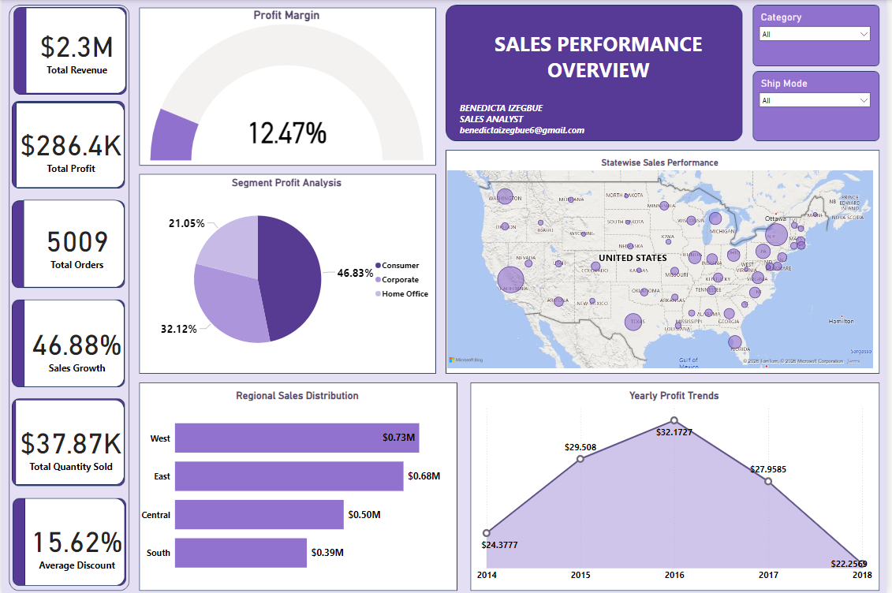
DASHBOARD

Slide 7
KEY BUSINESS INSIGHTS
SALES & PROFITABILITY
The West Region generated the highest sales and profit.
Technology was the best-performing category.
Some Furniture products generated low or negative profit.
DISCOUNT IMPACT
Higher discounts reduced profit margins significantly.
Several products recorded losses despite strong sales volume.
TREND ANALYSIS
Profit peaked around 2016 before declining afterward.
Seasonal sales fluctuations were visible across years.
GEOGRAPHIC INSIGHTS
California and New York contributed significantly to overall sales.
Some states had strong sales but weak profitability.

Slide 8
BUSINESS RECOMMENDATIONS
IMPROVE PROFITABILITY
Reduce excessive discounting on low-margin products.
Review pricing strategies for underperforming categories.
PRODUCT STRATEGY
Focus more on high-performing Technology products.
Re-evaluate poorly performing Furniture sub-categories.
REGIONAL GROWTH
Invest more resources in high-performing regions like the West.
Develop targeted strategies for low-performing states.
BUSINESS INTELIGENCE
Continue using interactive dashboards for real-time monitoring.
Use KPI tracking to improve strategic decision-making.

Slide 9
CHALLENGES ENCOUNTERED DURING THE PROJECT
Data Challenges
Discount column contained many zero values.
Profit column included negative values.
Data cleaning and validation were required.
Technical Challenges
Building DAX measures for time intelligence
Designing an organized dashboard layout
Configuring map visualizations correctly
Ensuring visuals interacted properly with slicers
Dashboard Design Challenges
Selecting appropriate visualizations
Maintaining readability and consistency
Balancing dashboard aesthetics with functionality

Slide 10
CONCLUSION
This project successfully transformed raw Superstore sales data into a professional interactive dashboard using Microsoft Power BI.
PROJECT ACHIEVEMENTS
Built interactive visual reports
Developed meaningful KPIs
Identified business performance trends
Improved understanding of regional and product profitability
Demonstrated practical business intelligence skills
SKILLS DEMONSTRATED
Data Cleaning
Data Visualization
DAX Calculations
KPI Reporting
Dashboard Design
Business Insight Generation
Analytical Thinking
FINAL OUTCOME
The dashboard provides stakeholders with a clear and interactive way to monitor business performance and make data-driven decisions effectively.

